Slide 1

THE STATE OF UAS REGULATION

Slide 2
The FAA Modernization and Reform Act of 2012
Congress Mandated Safe Integration by Sept., 2015
Why is it taking so long?

Slide 3
FAA’s PRIMARY SAFETY CONCERNS FOR UAS
SEE AND AVOID
LOSS OF POSITIVE CONTROL

Slide 4
BUT…
(and this is a very big “BUT”…)

Slide 5
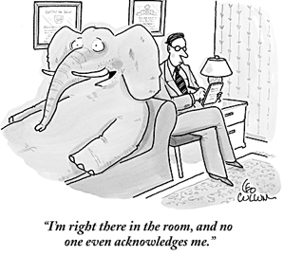
The FAA Isn’t a Police Force

Slide 6
Unduly burdensome regulations
Low risk of non-compliance
High level of non-compliance

Slide 7
AIMING FOR THE RIGHT MIX
SAFETY
MAXIMIZING COMPLIANCE
BURDEN

Slide 8
The FAA’s Proposed Rules for sUAS
More relaxed than expected:
No pilot license required
No requirement for airworthiness certification
No required coordination with ATC in Class G airspace (unless within 5 miles of an airport)
But:
Restricted to visual line-of-sight (operator or spotter), no night flights
One operator per flight – no autonomous flights
Operator certification requirements, TSA background check somewhat burdensome

Slide 9
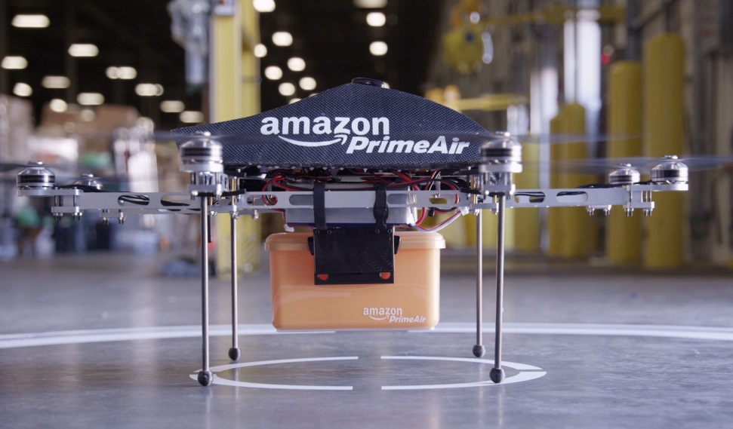
FAA Seeks Comments On:
Beyond VLOS
Air Carriers
Sense and Avoid
International
Towing/External Loads

Slide 10

IN THE MEANTIME….

Slide 11
Section 333 Exemption Petition Must
Identify the regulations from which you seek relief,
Extent and reasons for relief,
Benefit to the public interest,
How you plan to achieve equivalent safety.
Petitioner must also obtain a COA for the aircraft, itself.

Slide 12
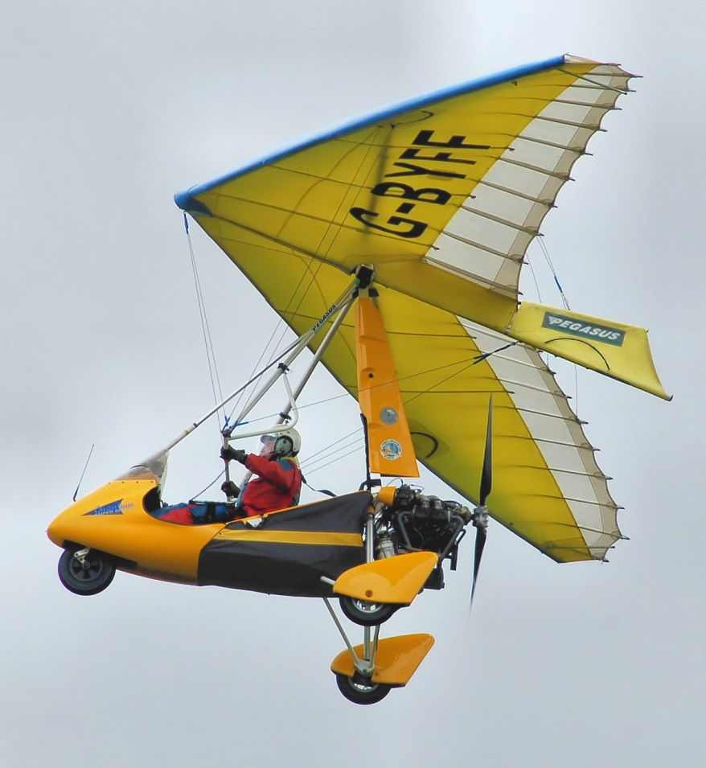
Requirements for Airman Certification;
Security Vetting;
Aircraft Marking;
Registration Requirements.
FAA Claims No Ability Under § 333 to Waive:

Slide 13
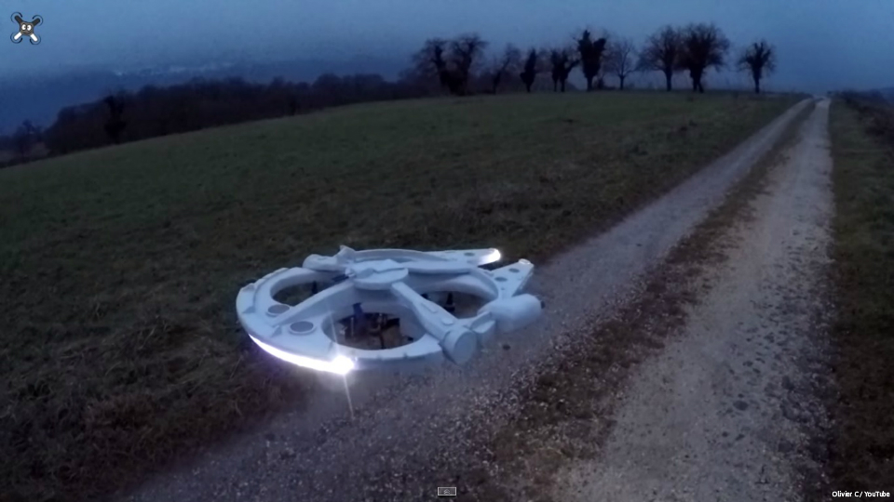
Model Aircraft Rules

Slide 14
KEY DIFFERENCES
Model Aircraft Rules
Proposed Commercial Rules
No operator certificate required, but follow community-based standards
Strict VLOS – no FPV or other visual aids
Below 400 ft AGL
No registration required
Need operator certificate, pass aeronautical knowledge test
VLOS satisfied IF operator capable
Below 500 ft AGL/Class G
Class B, C, D or E ok with ATC authorization
Aircraft must be registered
Visual observer

Slide 15

Does this make any sense?
Hobbyist:
No License, Registration
Professional:
Licensed, Registered

Slide 16
What About Private
(non-Recreational) Use?
Can You Use a Drone To:
Inspect the roof on your house?
Survey private, non-commercial land?
Make an aerial video to sell your family home?
The FMRA & FAA Are Silent

Slide 17
Public Entities
Governmental agencies – state, local, and federal – must obtain a COA.
Must be for a governmental purpose.
Applications evaluated on an individual basis.
Proposed sUAS Rules give public entities option of complying with new Section 107

Slide 18

State Regulation

Slide 19
As Long As It Doesn’t Interfere With Federal Regulations
A State Can:
A State Cannot:
Limit use by state & local law enforcement;
Limit use of evidence in state courts;
Address invasions of privacy;
Hear tort, contract, and insurance claims;
Encourage investment.
License operators;
Certify aircraft or service facilities;
Grant immunity for damaging a UAS;
Regulate use of navigable airspace.

Slide 20

Thanks, and Safe Flying! www.diazreus.com

